Slide 1
Data Science Capstone Project Report Presentation
Luis Resende Silva

Slide 2
Business Problem
What are the best neighborhoods in Rio de Janeiro to start a new gym?
Challenge
To choose between 163 neighborhoods
having hundreds of features available.

Slide 3
DATA SOURCES
Rio de Janeiro Public Data Portal: Data.Rio
Global Location Database: Foursquare Places API

Slide 4
DATA COLLECTION

Slide 5
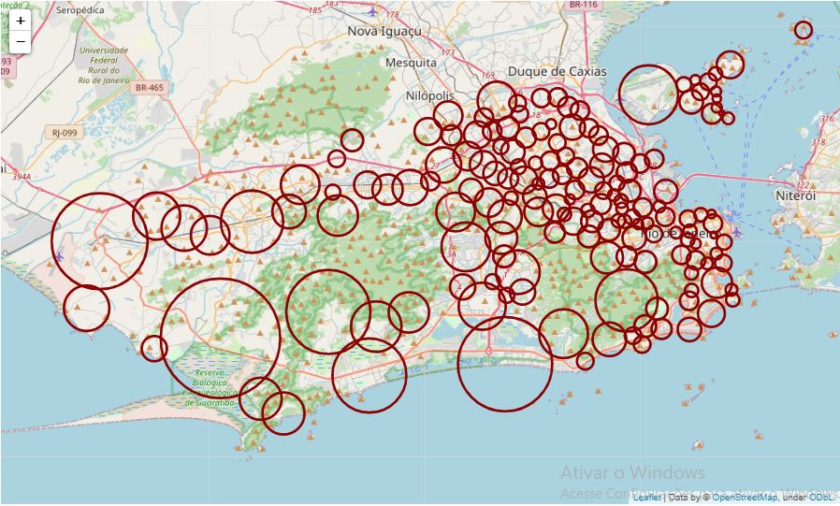
Neighborhood Areas for Gym Search
Coordinates acquired using the geocode method of the geopy library.
Manual corrections of the coordinates and radiuses.
City visualization constructed with the folium library.

Slide 6
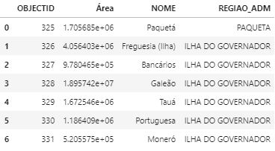
Neighborhood Area Table

Slide 7
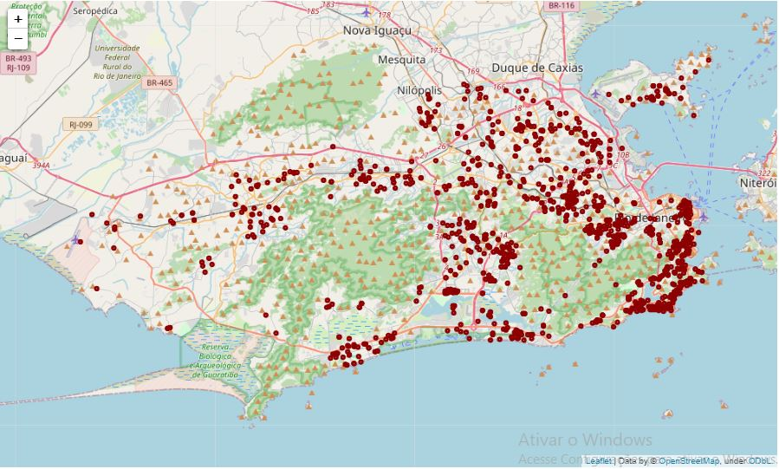
Gym Search
Neighborhoods searched iteratively using the Foursquare Places API.
API Request Inputs:
Center coordinates
Estimated radiuses
Venue category id (Gyms)

Slide 8
Gym Search
Result table features :
venue name
id
category
category id
latitude
longitude
venue
distance from neighborhood center
neighborhood

Slide 9
DATA CLEANING
Neighborhood’s names formatting and uniformization
Index or columns settings
Table formatting
Dropping empty or unimportant columns or rows
Dropping duplicates
Dealing with missing values
Type conversions
Merging tables

Slide 10
FEATURE SELECTION
Income Features:
Population with income responsible for the permanent private residences per Km2
Total monthly income of the population responsible for the permanent private residences per Km2
Average nominal income of the population responsible for the permanent private residences
Commercial Features:
Retailing
Credit institutions, insurance and capitalization
Trade and administration of real estate, securities, technical services
Accommodation, food, repair, maintenance, writing services
Medical, dental and veterinary services
Education

Slide 11
FEATURE ENGINEERING
Demography Features:
Target demographic density (ages 15 to 29)
Adult demographic density (ages 18 to 65)
Gyms Features:
Gyms per Km²
Gyms per 10.000 target Inhabitants
Gyms per 10.000 adult inhabitants

Slide 12
NEIGHBORHOOD CLUSTERING
Feature groups for maximization:
Income
Demographics
Industry establishments
Feature group for minimization:
Gyms
This approach consists on looking for neighborhoods that match this predefined profile. By segmenting the neighborhood sample using a clustering algorithm the existing profiles can be exposed and the neighborhoods matching the target profile selected.

Slide 13
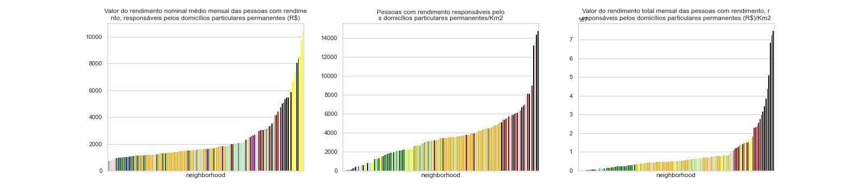
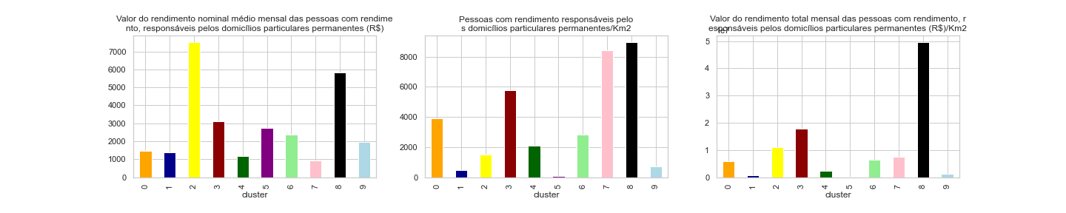
Income Clusters
Income clusters bar plots
Income Clusters Averages Bar Plots

Slide 14
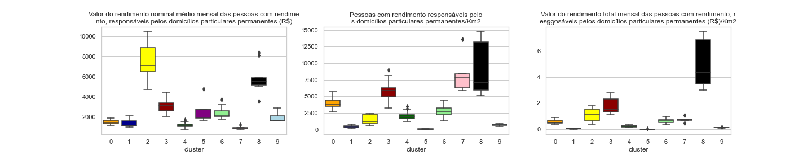
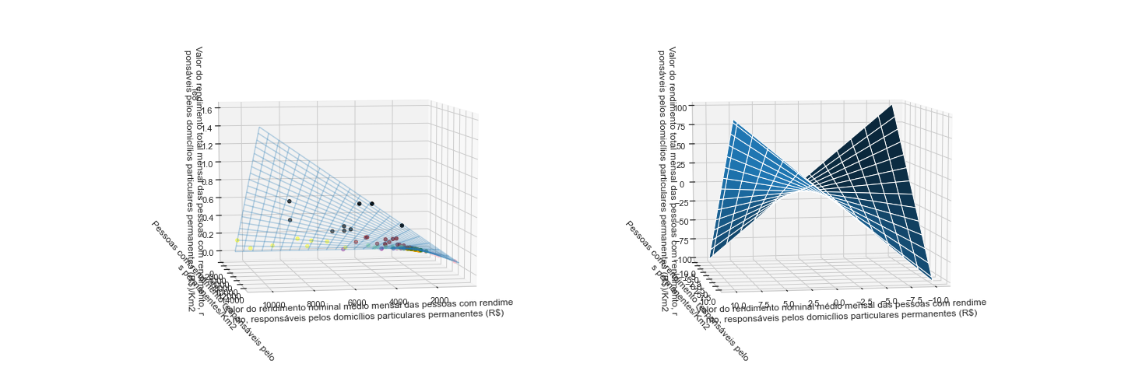
Income Clusters
Income clusters boxplots
Income Clusters 3D Scatter and Surface Plots

Slide 15
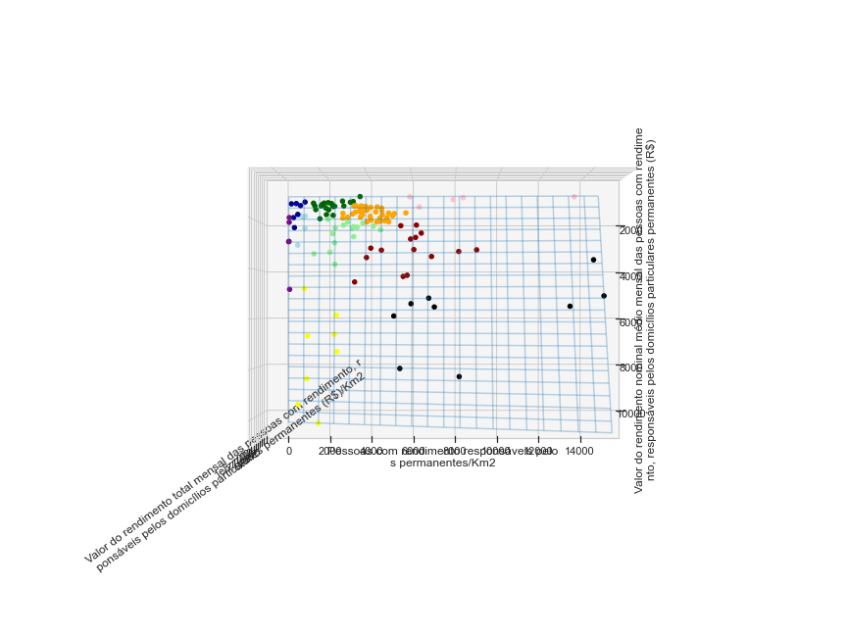
Income Clusters
Income Clusters 3D Scatterplot - Topview
Income Clusters Averages Bar Plots

Slide 16
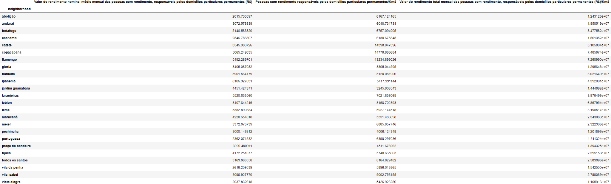
Income Based Recommendation

Slide 17
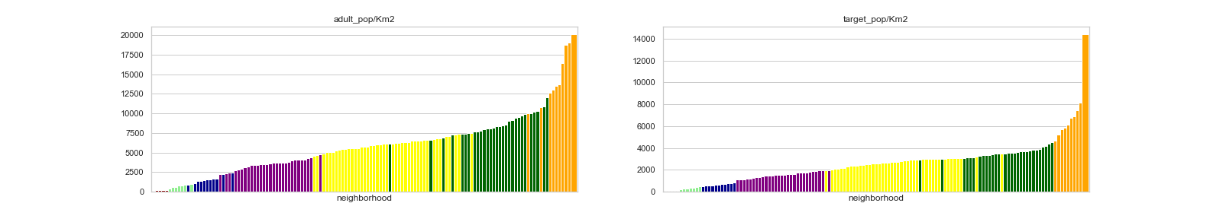
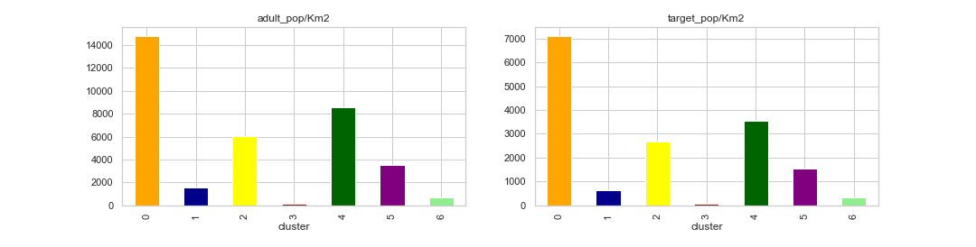
Demography Clusters
Demography Clusters Bar Plots
Demography Clusters Average Bar Plots

Slide 18
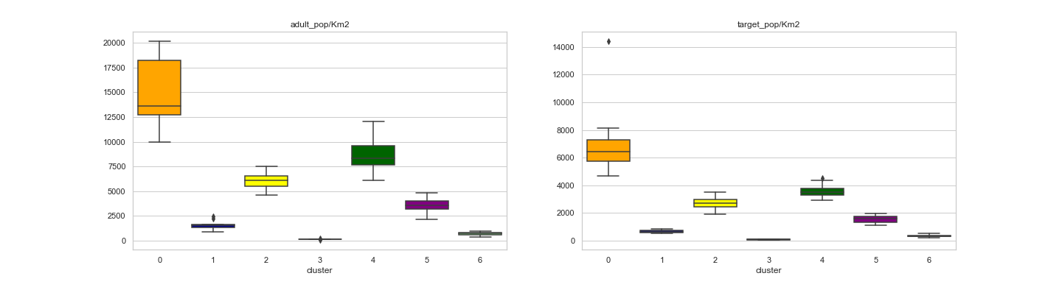
Demography Clusters
Demography Clusters Boxplots

Slide 19
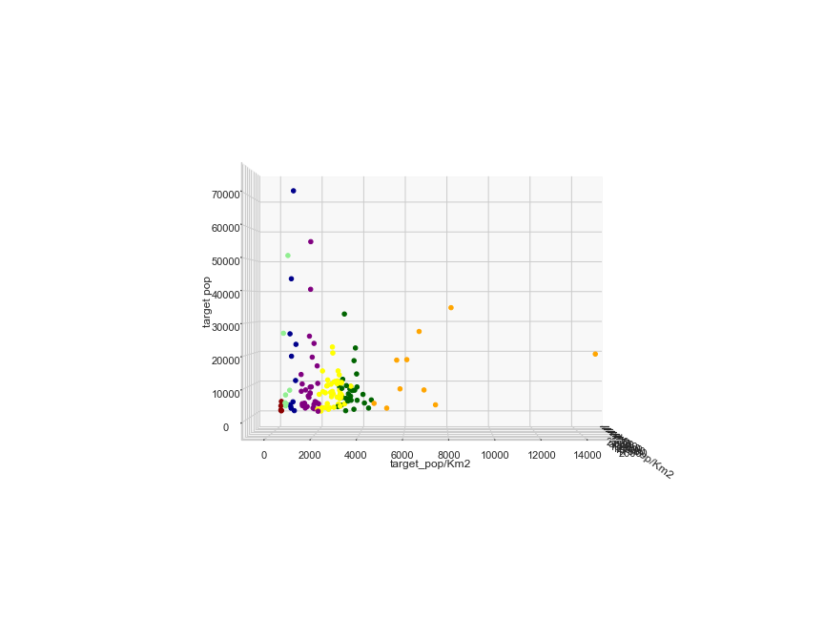
Demography Clusters
Demography Clusters 3D Scatterplot - Sideview

Slide 20
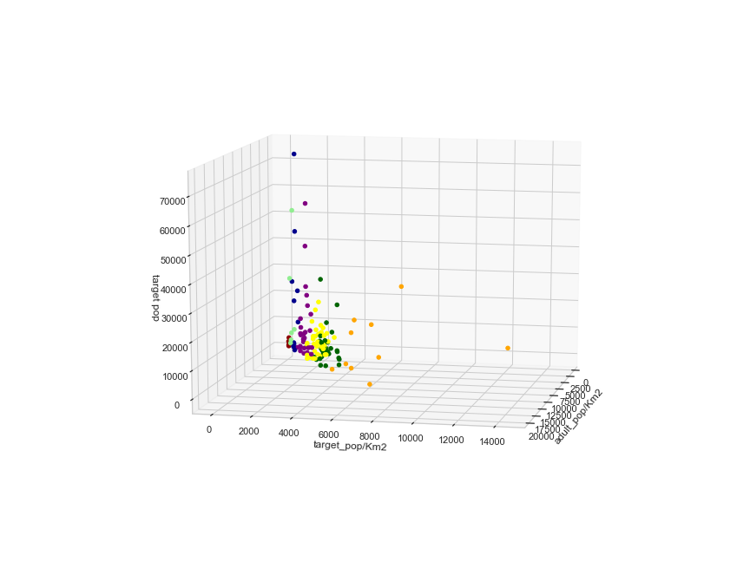
Demography Clusters
Demography Clusters 3D Scatterplot - 24°

Slide 21
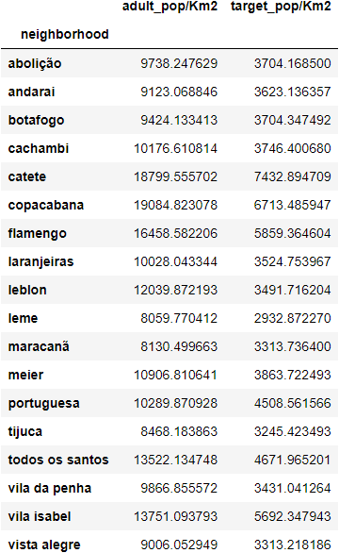
Demography Based Recommendation

Slide 22
Income Based Recommendation

Slide 23
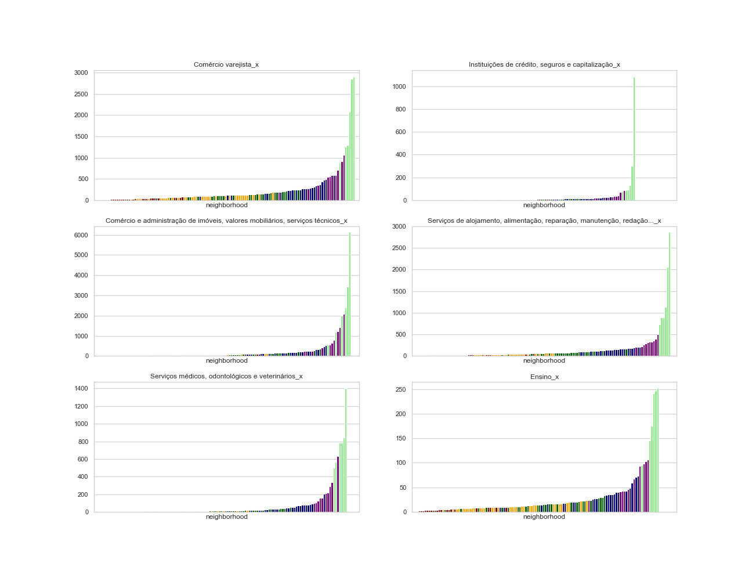
Commercial Establishments Clusters
Comercial Clusters Bar Plots

Slide 24
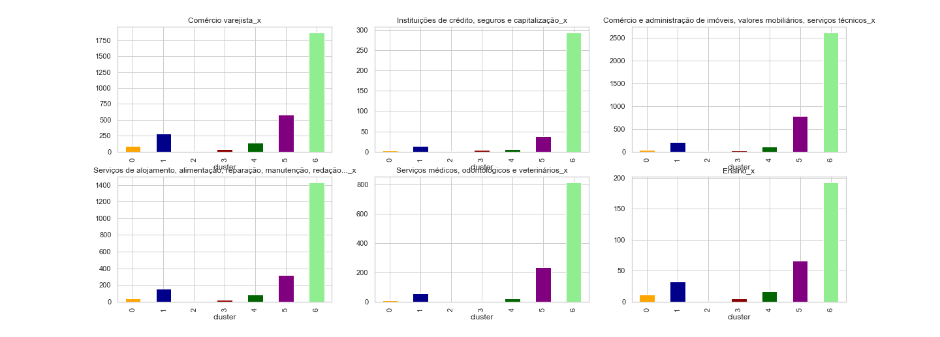
Commercial Establishments Clusters
Comercial Clusters Average Bar Plots

Slide 25
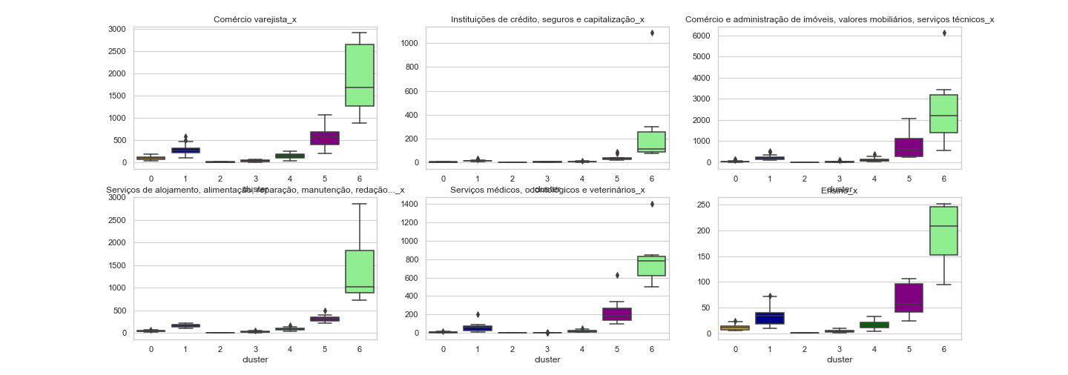
Industry Establishments Clusters
Commercial Establishments Clusters
Commercial Clusters Boxplots
Industry Clusters Bar Plots

Slide 26
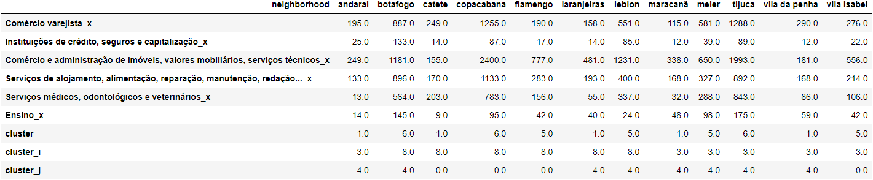
Commercial Establishments Based Recommendation

Slide 27
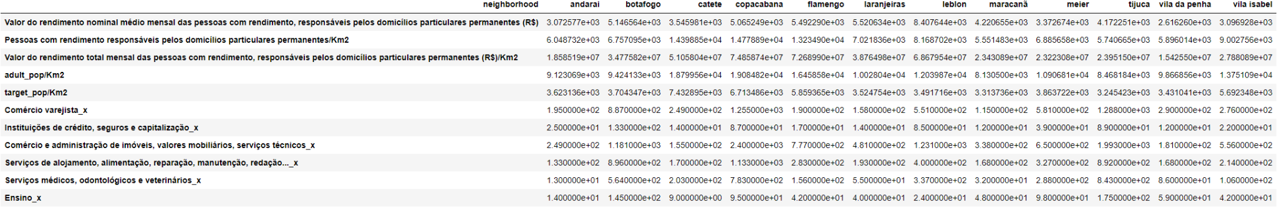
General Neighborhood Recommendation for Investment in Commerce

Slide 28
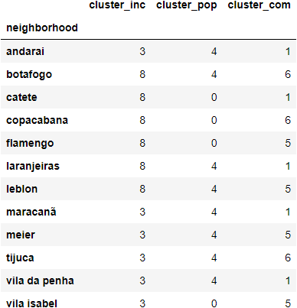
General Neighborhood Recommendation - Clusters Index

Slide 29
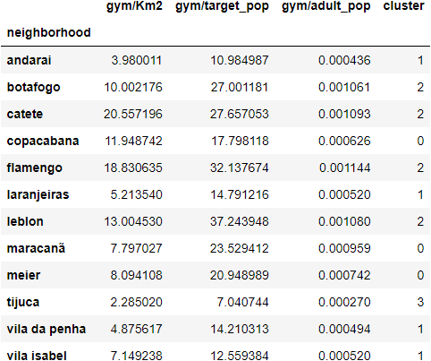
General Neighborhood Recommendation - Gyms Features

Slide 30
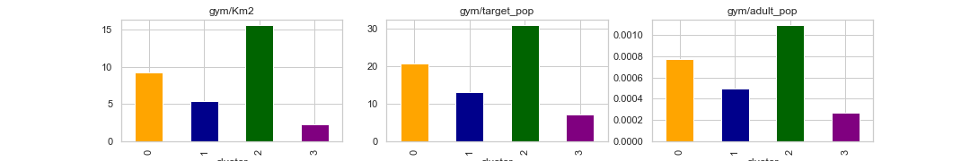
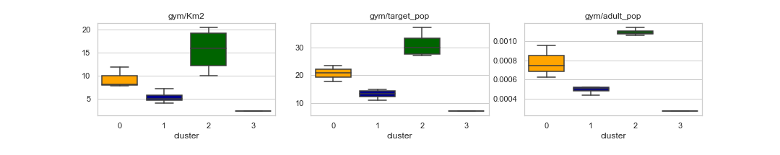
Gyms Clusters
Gyms Clusters Average Bar Plots
Gyms Clusters Boxplots

Slide 31
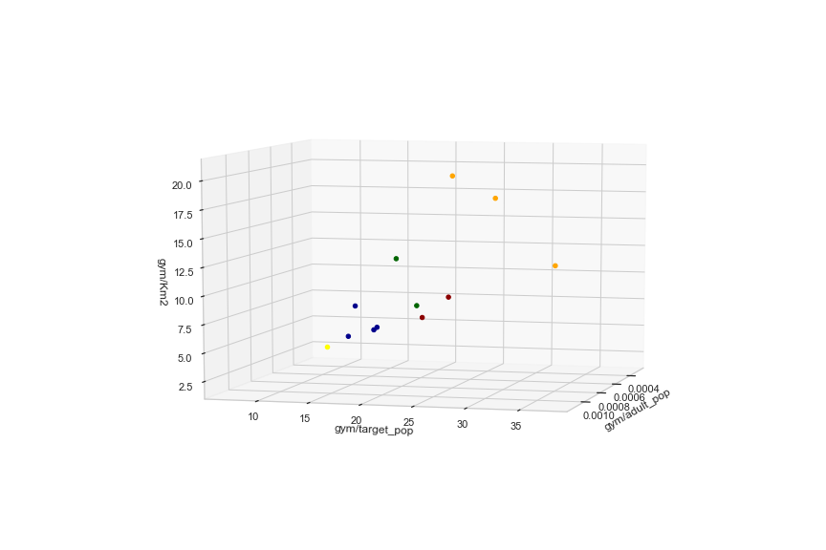
Gyms Clusters
Gyms Clusters 3D Scatterplot - 15°

Slide 32
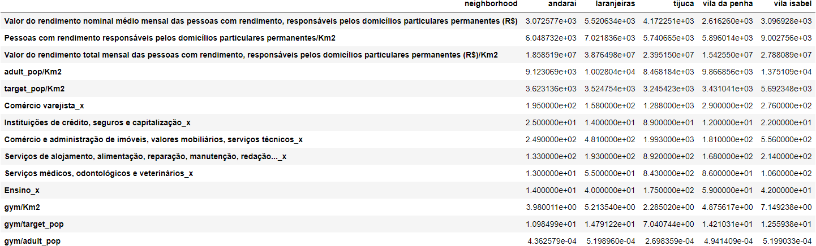
Neighborhood Recommendation for Investment in Gyms

Slide 33
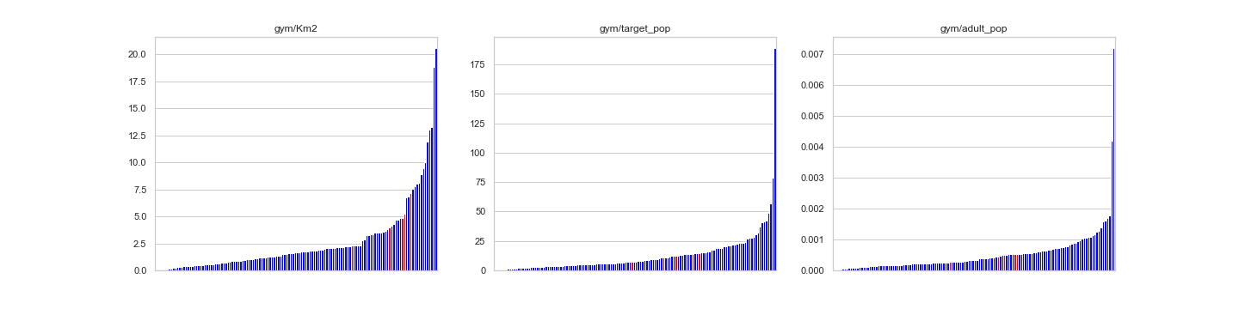
Gyms Clusters
Selected Neighborhoods Comparison Against Sample - Gym Feature Group

Slide 34
PRESENTATION END

